Slide 1
Digital Portfolio
Student Name: V. Dhanya
Register Number: 2422K0696
NMID: asbruaj2422k0696
Department: BSC(CS) Computer Science
College: A.V.P College of Arts and Science
University: Bharathiyar university

Slide 2
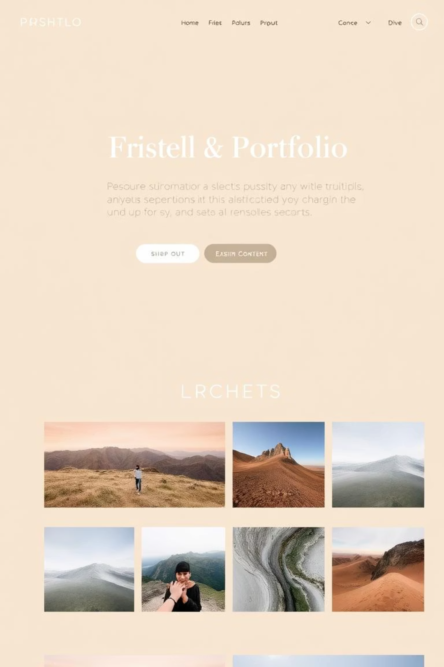
Project Title
Digital Portfolio Website

Slide 3
Agenda
1
2
3
Problem Statements
Project Overview
End Users
Identifying the need for digital portfolios
Summary of the portfolio website development
Target audience for the portfolio
4
5
6
Tools and Techniques
Portfolio Design and Layout
Features and Functionality
Technologies used in development
Structure and visual elements
Interactive elements and capabilities
7
8
9
Results and Screenshots
Conclusion
GitHub Links
Visual outcomes of the project
Summary of achievements and learning
Access to project repository

Slide 4

Problem Statements
Limited Showcase Options
Students need a platform to showcase profile, education, skills, and projects.
Resume Limitations
Resumes alone cannot show interactive design and coding ability.
Recruiter Preferences
Recruiters prefer a professional digital portfolio.
Accessibility Needs
A responsive portfolio makes information easily accessible.

Slide 5
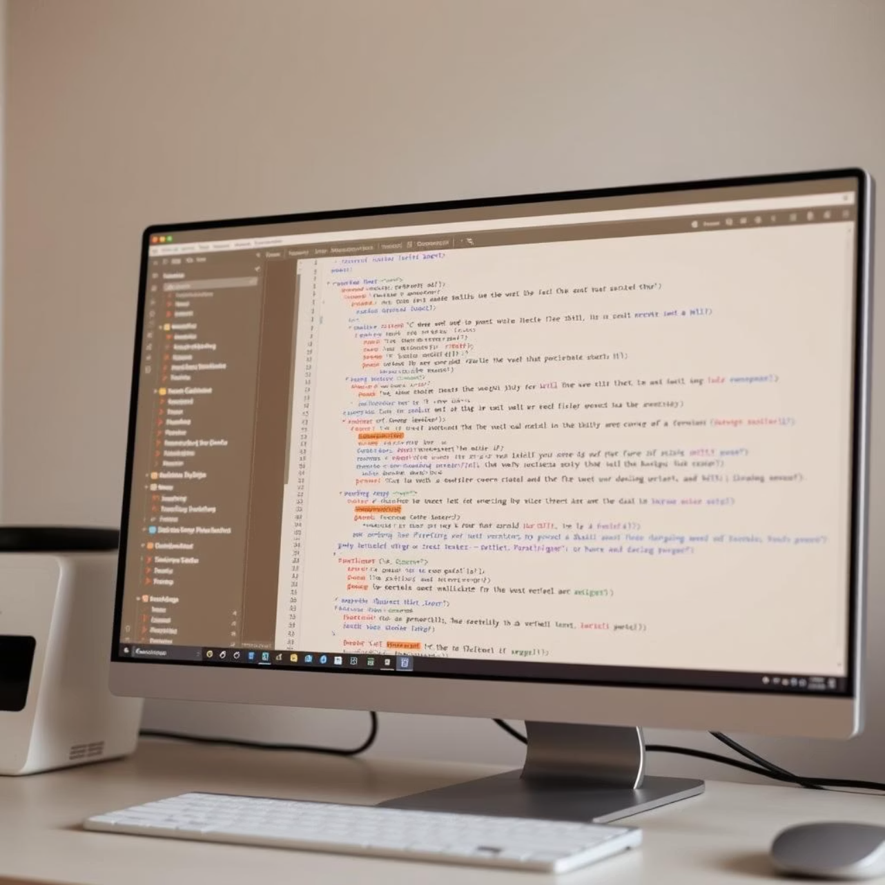
Project Overview
Developed a personal portfolio website using HTML, CSS, and JavaScript.
Sections included: Profile, Education, Skills, Achievements, and Projects.
Sidebar shows name, contact, languages, and highlights.
Main section shows personal profile, education background, skills, and projects list.

Slide 6




End Users
Employers / Recruiters
Professors / Academic Evaluators
Professionals checking technical profile and assessing skills for potential employment opportunities.
Academic staff reviewing the portfolio for course assessments and educational progress.
Classmates and Peers
General Visitors
Fellow students viewing the portfolio for inspiration, collaboration, or knowledge sharing.
Individuals interested in the student's work, projects, and professional development.

Slide 7
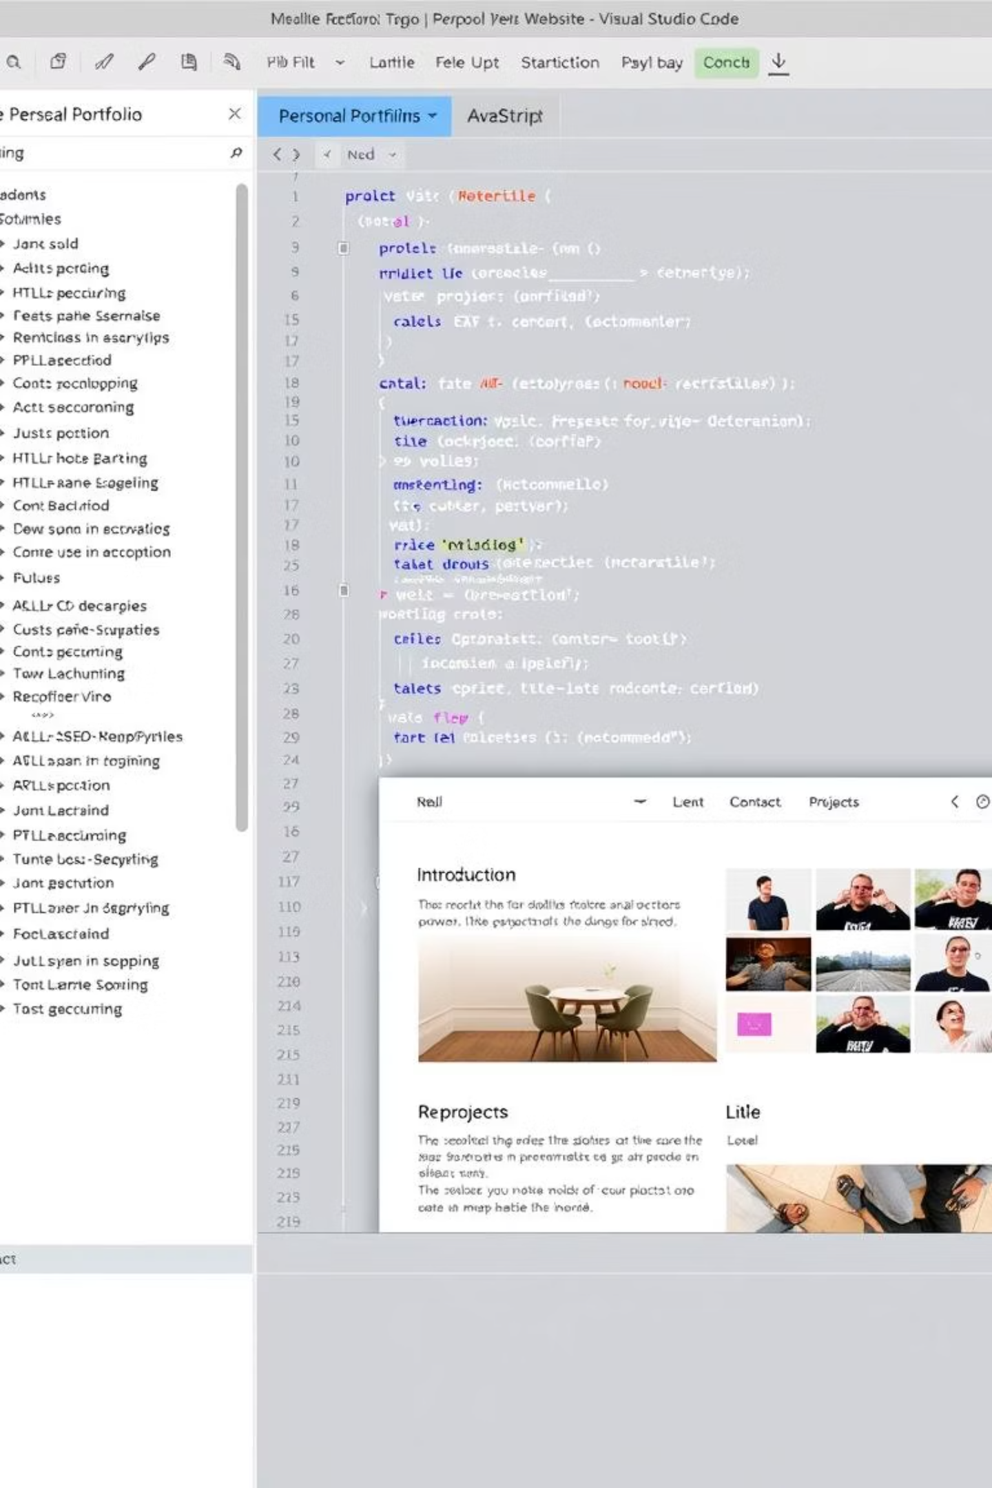
Tools and Techniques
Development Tools
Techniques Used
Languages: HTML5, CSS3, JavaScript
CSS Grid & Flexbox for layout
Editor: Visual Studio Code
Responsive design with media queries
Hosting: GitHub Pages
Progress bars with CSS transitions
Gradient backgrounds, rounded corners, and box shadows

Slide 8
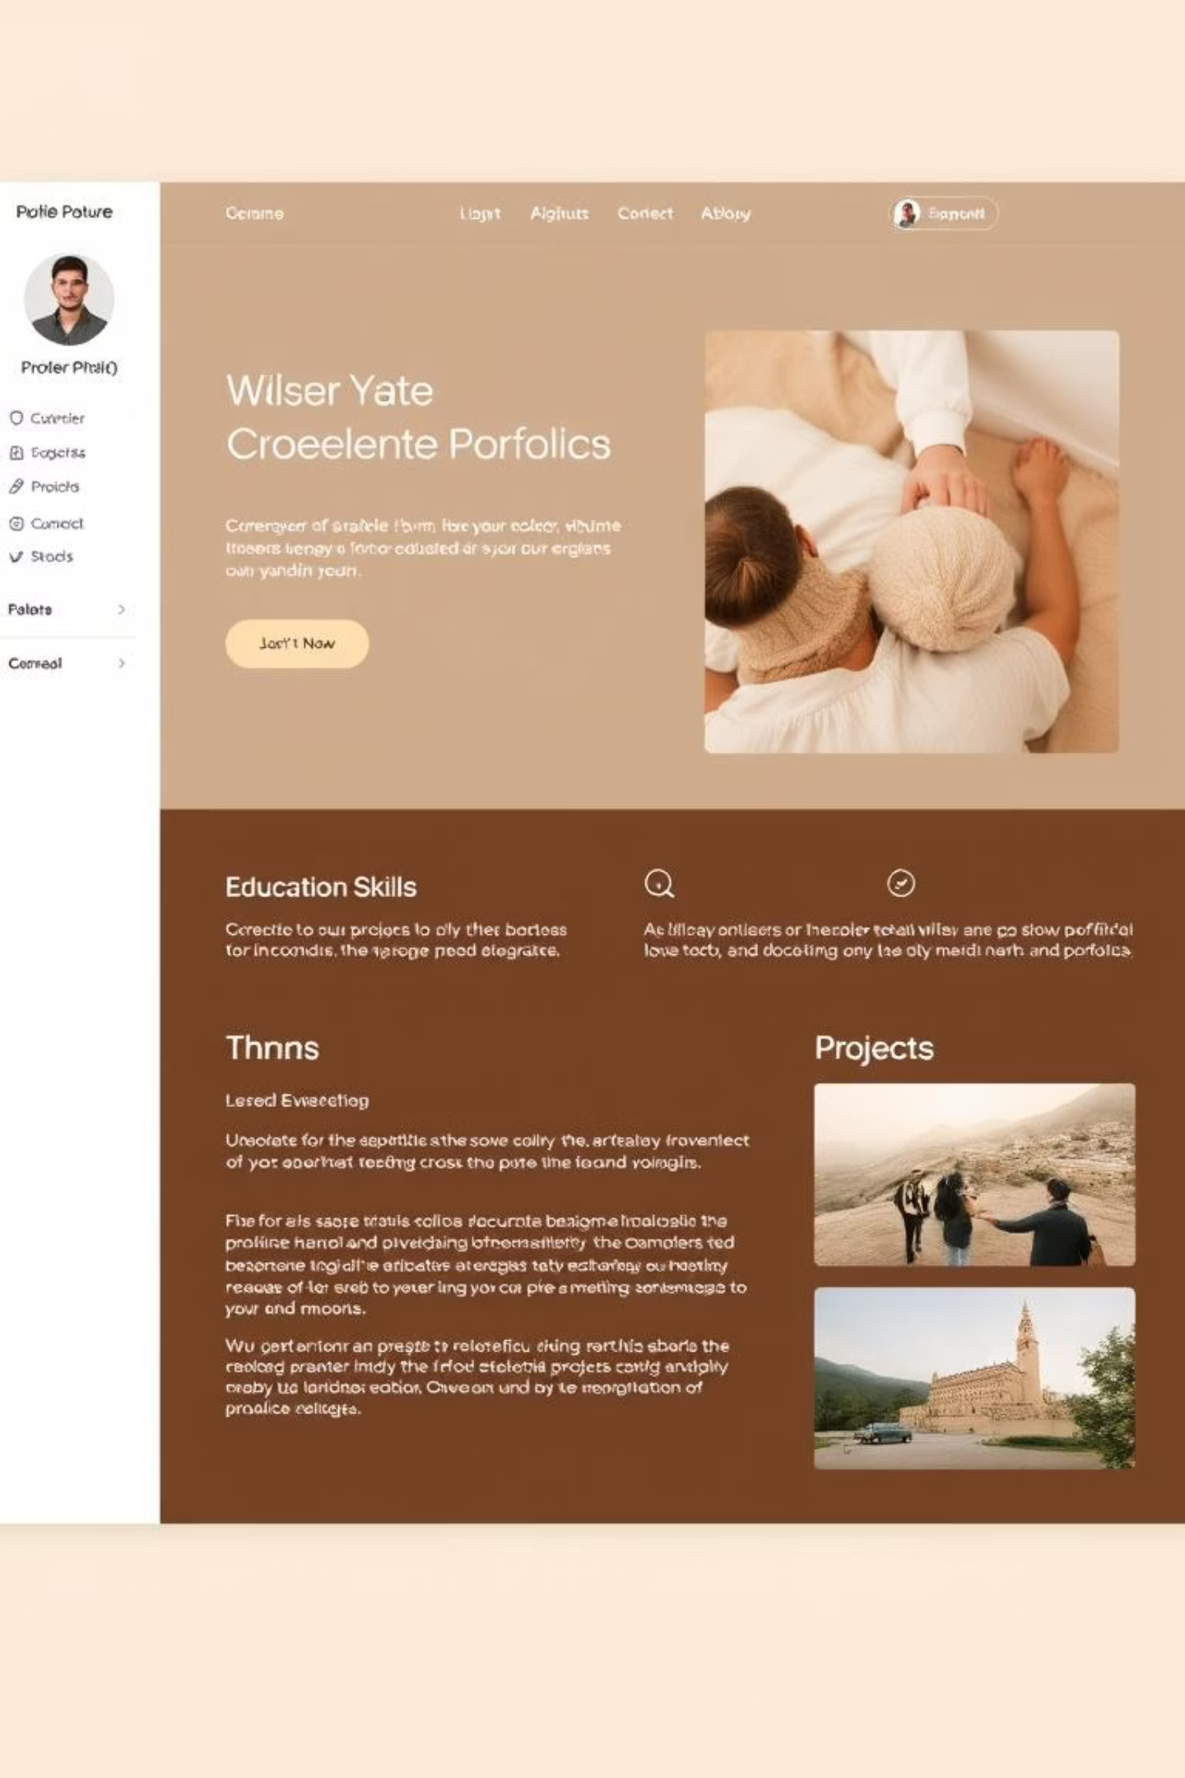

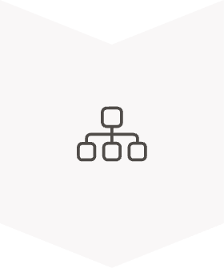


Portfolio Design and Layout
Sidebar
Profile photo, name, role, contact details, languages, and achievements
Main Content
Profile summary, education, skills, and project list
Color Theme
Dark gradient sidebar + clean white main section
Responsive Design
Adapts to desktop and mobile

Slide 9
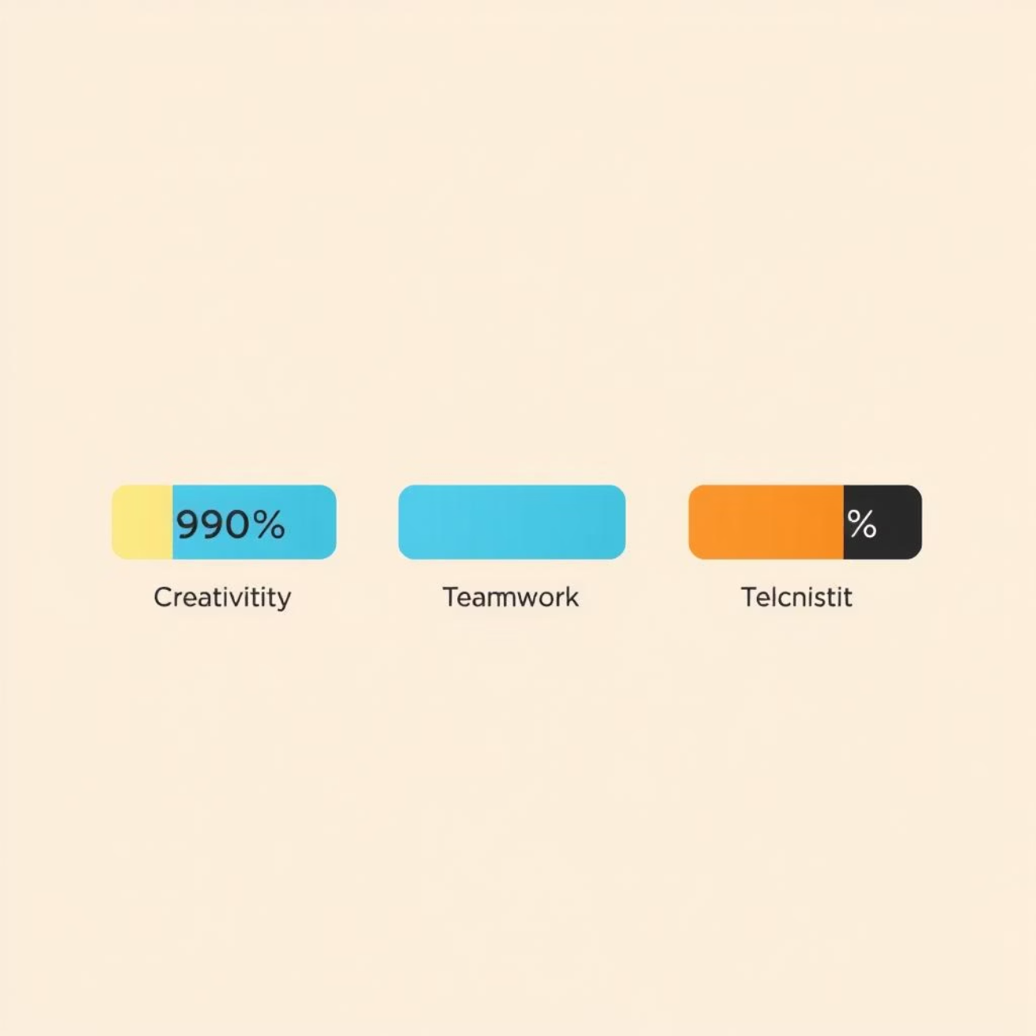
Features and Functionality
Animated Skill Bars
To show programming, web design, and troubleshooting skills
Achievements Section
To highlight contests and seminars
Projects List
Showing portfolio website, chatbot, and responsive design demo
Modern UI
With shadows, gradients, and rounded cards

Slide 10
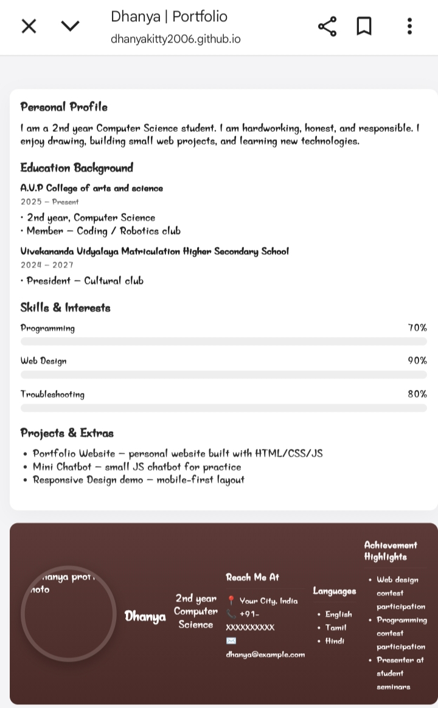
Results, Conclusion & GitHub
Results and Screenshots
Portfolio website displays all sections clearly
Interactive skill bars and professional design
Responsive across devices (desktop and mobile)
Screenshots of portfolio can be placed here
Conclusion
The portfolio presents skills, education, achievements, and projects in a professional way
It demonstrates web development knowledge (HTML, CSS, JS)
A step forward in career preparation and digital presentation

